Slide 1
ITCS 6010
DATA INTEGRATION
TOPIC PRESENTATION

Slide 2
Topic
Software as a Service (SaaS): An Enterprise Perspective
Microsoft Corporation, October 2006
Authors:
Gianpaolo Carraro
Fred Chong

Slide 3
What is SaaS
  Imagine a system
    where you don't have to buy new hardware or update software
    where you pay nothing or pay as much as you use
    where everything is done as a service: Infrastructure, computing, storage and usage
    where you don't worry about your resources spent on Infrastructure security and operational security
    where you cut your IT spendings by 99%
    where you have freedom of usage from anywhere with internet connectivity
    which is eco-friendly

Slide 4
Example
Storage of your documents, personal images, music, contact information, etc
    On your Desktop/laptop Vs Cloud
      Cost
        A PC with 1 GHz x86 processor, 1GB of system memory (RAM) , 10GB of hard-drive space (although this can be split onto 2 drives of a 5GB each ) and Graphics card and monitor capable of 1024 by 768, would cost $70 (?)
      Reliability
      Ease

Slide 5
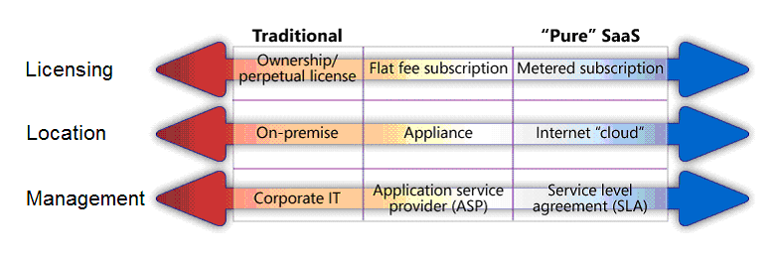
Considerations for Embracing SaaS

Slide 6
Service-Centric IT
  SaaS provides the right incentives for guiding IT towards a service-centric model.

Slide 7
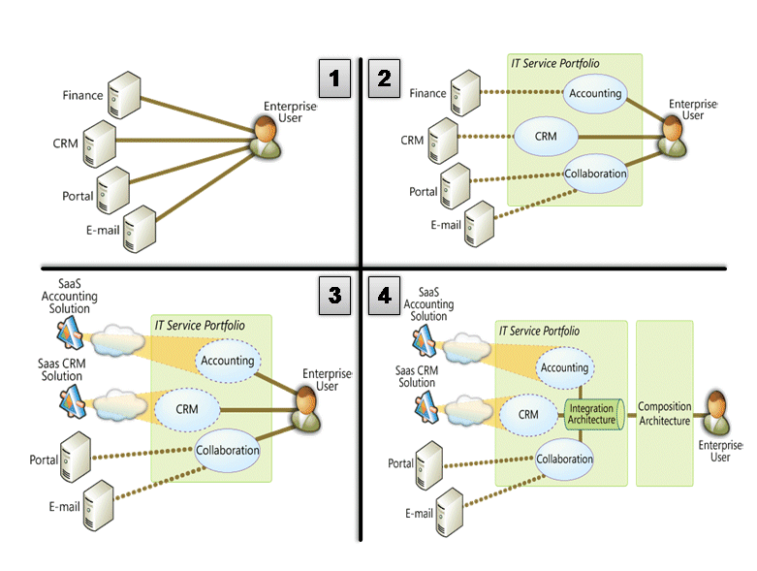

Slide 8
Maturity model of the service-centric IT
LEVEL 1
  Enterprise user needs are rudimentarily addressed by a collection of siloed applications.
LEVEL 2
  Enterprise user needs are better addressed through a service portfolio.

Slide 9
LEVEL 3
  Service portfolio is enhanced with additional options coming from SaaS providers.
LEVEL 4
  On-premise services are seamlessly integrated.

Slide 10
How SaaS Affects IT
DATA SECURITY STANDARDS
  Assess your data-security needs, and ensure that the provider has measures in place to meet the standards you set.
SLA GUARANTEES
  service-level agreements (SLAs) that guarantee the level of performance, availability, and security that the SaaS vendor will provide.

Slide 11
MIGRATION STRATEGIES
  Migrate away from a SaaS application to another solution.
IN HOUSE INTEGRATION REQUIREMENTS
  Ensure that migrating to SaaS will meet any functional and data-integration requirements your organization has in place.

Slide 12
ARE THESE SUFFICIENT ?
Reporting services
  SaaS involves giving up direct control of some of your data, accurate and useful reporting is especially important.

Slide 13
IMPACTS
IT Roles and Responsibilities
  SaaS as an option, control of the data center does not necessarily equal control over the entire enterprise-computing environment.
  CIO - role of gate-keepers who maintain data center.

Slide 14
Regulatory Compliance
Statement on Auditing Standards No. 70 (SAS 70)
  SAS 70 is not a stamp of approval
  SAS 70 report only documents the internal control practices of an organization, without offering any judgment as to whether they are satisfactory.

Slide 15
Data integration (SaaS)

Slide 16
What is data integration?
  Specifies how you bring a data originated from outside into your logical infrastructure.
  Transferring data from one or more existing applications or data repositories into the new system this may include the fallowing scenarios
    Bootstrapping
    SaaS dependant on data produced onsite.
    A program on site makes use of data produced by SaaS.

Slide 17
Integration Broker
  Data can be of various formats.
  Integration broker -
    Takes data from a variety of sources
    Determines how and where the data needs to be processed and routed.
    Sends each piece of data to its destination in a form that the target system can use.

Slide 18
Working of an integration broker
  Pipeline architecture.
  Data enters- data channel which defines the communication protocol.
  A metadata service provides the configurable rules that each module uses to do its job.
  Common integration operation
    Security - Authenticates the data obtained
    Validation - Checks schemas
    Synchronization workflow- Synchronizes data flow to maintain data consistency.
    Routing - Determines the path the data takes to its destination.

Slide 19
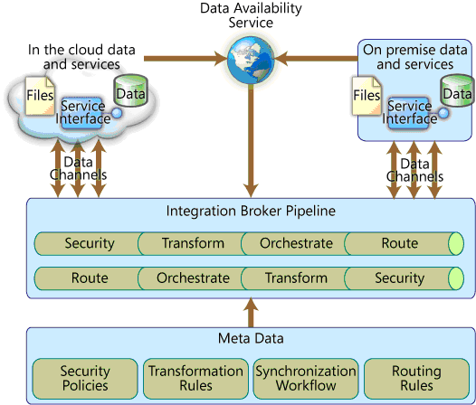

Slide 20
Which of the following is the most apt synonym for an integration broker?
  A Manager who writes a letter to a company.
  A person who proof reads the letter given by the manager to check for errors and also attests the writer's signature before sending the letter to the right person.
  A person who receives the letter from the manager.

Slide 21
Data Availability pattern
  A Service that provides the means by which the integration broker can detect when new data is available.
  Methods of data synchronization.
    Pull
    Push
    Publish and Subscribe
  Factors considered to choose a sync method-
    The requirement of accuracy.
    Number of source or data sink.
  Must strike a perfect balance.

Slide 22
What are the different methods of data synchronization?
  Push,Pull,Pop
  Revert
  Publish and subscribe
  1&3
  1&2

Slide 23
Data transfer
There are two type of data transfer
    Synchronous
      Data when requested id expected immediately
      FTP,HTTP
    Asynchronus
      Data is requested and processed at different times.
      SMTP.

Slide 24
Data Transformation
  Taking data from one source, and altering its format and/or content so that it can be used by the data sink.
  Exchanging data with a SaaS application can involve some degree of data transformation.
  Steps involved in data transformation:
    Validation of the incoming data.
    Combining data from a different source.
    The data itself is converted to the target format.

Slide 25
Which is an example of a synchronous data transfer?
  HTTP
  FTP
  SMTP
  1&2
  Cannot tell

Slide 26
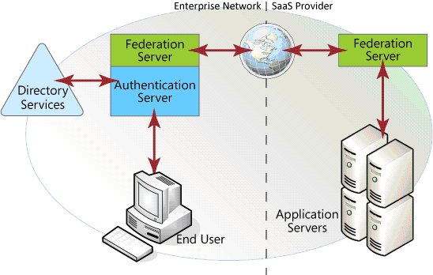
Highlights of SaaS
  Firewall should not be a issue.
  Single sign-on Authentication method
    Use of a federation server in both the enterprise and the SaaS end

Slide 27
COMPOSITION ARCHITECTURE

Slide 28
Composition Architecture
  Composite Application
  Business functions and informations integrated effectively
  Benefits
    reduces redundant data entry
    better human collaboration
    improved visibility
    awareness of outstanding tasks and their statuses

Slide 29
Composition Architecture
  Business Intelligence - required information in all dimensions
  Process Intelligence - improved view of user tasks and responsibilities
  Domain Intelligence - preexisting knowledge of how the business and its processes work

Slide 30
Composition Architecture
Objective:
  create task-focused composite applications
  bring "business intelligence" and "process intelligence" together
  in single package
Challenge: is it easy ?
  different applications, protocols, technologies
  different sources, different types, different locations

Slide 31
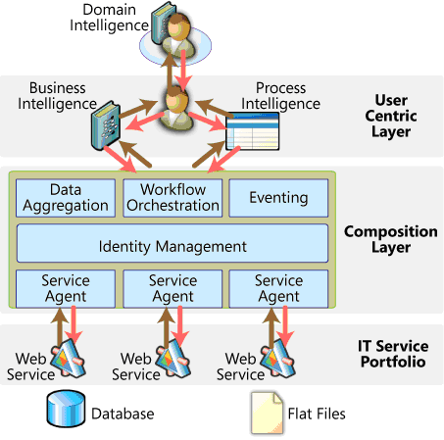
Composition Architecture

Slide 32
Composition Architecture
Lowest Level: Sources
Sources - internal application, internal databases, SaaS applications, web services, flat files,....
Sources - provide stored or processed data as "raw materials"
How to access these sources ?
- APIs and Web services

Slide 33
Composition Architecture
Composition Layer :
data -> business information and process intelligence, and vice versa
composed of:
  service agents
  identity Management
  data aggregation
  work flow orchestration
  eventing

Slide 34
Composition Architecture
  Service agents
- negotiating connections and exchanging messages with each service.
  Identity Management
- authentication and credentials
  Data aggregation
- takes information from data sources and transforms it
  Workflow component
- organizes the information with conditions and flows
- guides human interaction and collaborations
  Eventing mechanism
- enables notification based on conditions

Slide 35
Composition Architecture
User-Centric layer:
  presents the composite data to the user in a central, integrated, task-focused user interface
  provides information for decision making and functionality for taking action

Slide 36
Match the following
a. Business Intelligence
b. Process Intelligence
c. Domain Intelligence
1. Preexisting knowledge of how business and process work
2. required information from different dimensions
3. Improved view of user tasks and responsibilities

Slide 37
Answer
a2 b3 c1

Slide 38
Question
Which is the best service that can be used in corporate IT environment?
a. on-premise services
b. on-cloud services
c. both
d. none

Slide 39
Business: Becoming a SaaS provider
Dependent entities: franchisees, resellers .,,
Valuable IT asset
Central business can host
  specialized applications for franchisees
  business functions: inventory control, accounting, promotions, loyalty programs, and so on

Slide 40
Summary
  consider flexibility and risk management implications of adding SaaS to portfolios of IT services.
  Integration and Composition architecture - incorporates SaaS successfully
  Symbiotic harmony between On-premise and in-the-cloud services

